Slide 1
UNIT I – Hour I
FUNDAMENTALS OF SE AND REQUIREMENT ENGINEERING
Topic: Introduction to Software Engineering

Slide 2
Software Engineering
Software engineering (SE) is the application of a systematic, disciplined, quantifiable approach to the design, development, operation, and maintenance of software and the study of these approaches; that is, the application of engineering to the software.
The term software engineering first appeared in the 1968 in NATO Software Engineering Conference and was meant to provoke thoughts regarding the perceived "software crisis" at the time.

Slide 3
What is the difference between software engineering and system engineering?
System engineering is concerned with all aspects of computer-based systems development including hardware, software and process engineering. Software engineering is part of this process concerned with developing the software infrastructure, control applications and databases in the system.
System engineers are involved in system specification, architectural design, integration and deployment.

Slide 4
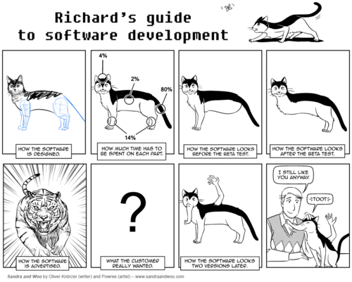
Software Engineering
What do you mean by Software Engineering?
Notes:
Ask the students as question and wait them for their answer

Slide 5
Software Engineering
Is "Software Engineering" the same as “Engineering”?
How are bridge building and software development similar, how are they different?
Notes:
To give you a few ideas and some perspective on the above question: http://www.cs.usfca.edu/~parrt/doc/software-not-engineering.html

Slide 6
Building Bridges vs. Building Software
Issue | Bridge | Software
Complexity
(Im)perfect engineering
Maintenance
Collapse
Earliest bridges were tree trunks across rivers. Fundamental bridge designs don't change rapidly. You can touch all of the components and customer demands are not likely to change from project start to finish.
50 years (only) of software dev, rapidly evolving principles and methods. Customer demands can change, components interact with each other in unexpected ways.
Built to withstand all expected conditions. Expected and unexpected conditions can be quantified.
Cannot always anticipate all unexpected conditions of use.
Usually minimal…replacing bolts, cables, painting, etc.
50% of OS code rewritten in 5 year period. Numerous bugs to fix, updates to functionality.
Rebuild rather than repair…catastrophic, possible loss of life.
Considered "normal," make reboots quick. Only life threatening in special cases.

Slide 7
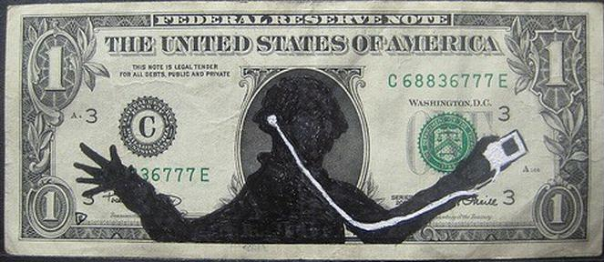
Truth
What drives software engineering practices in the real world?
  The Almighty Dollar $$$
The software engineering technique/methodology is employed will be influenced by the demands of the customer, the capabilities of the software development company employed, the complexity of the software, whether or not the developer is responsible for maintenance of the product and perhaps most importantly, how much the customer is willing to pay.
Notes:
Image source: http://www.funnypica.com/top-40-funny-pictures-of-dollar-modifications/crazy-funny-money-drawing-art-12/

Slide 8
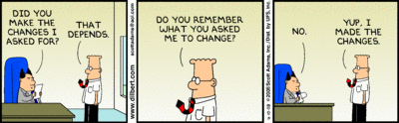
Is there is difference between Programmer and Software Engineer ?
A programmer is a puh-tey-toh. A software developer is a puh-tah-toh. A software engineer is a potato (in some states, a certified potato). Got it?

Slide 9
Is there is difference between Programmer and Software Engineer ?
Programmer is a subset of Software Engineer.
“real programmers implement sophisticated algorithms.”

Slide 10
Do we need software engineering?
All great software is written by small teams: look at unix (2 guys), Apple (started in a garage), …
Writing software is a creative process, an “art” or a “craft”, and cannot be engineered.

Slide 11
Past Studies on the State of Software Eng
Standish Group review of 9,000 major IT projects
Canceled
23%
Successful
28%
Canceled
24%
Successful
33%
Completed Late,
Over budget, and /or
With features missing
49%
Completed Late,
Over budget, and /or
With features missing
44%
2000
2010
Cutter Consortium (2002):
  78% of IT organizations have been involved in disputes that ended in litigation.
  In 67% of the disputes, the functionality or performance of the product did not measure up with the claims of the software developer.
  In 56% percent of those cases, the promised delivery date slipped several times.
  In 45% of the disputes, the defects were so severe that the system was unusable.

Slide 12
Ariane 5
June 4, 1996
European Space Agency lost newest rocket, the Ariane 5, successor to the Ariane 4

Slide 13
Ariane 5
Youtube Link:
http://www.youtube.com/watch?v=kYUrqdUyEpI
Youtube Summary:
“The launch ended in failure due to an error in the software design caused by inadequate protection from integer overflow. This resulted in the rocket veering off its flight path 37 seconds after launch, beginning to disintegrate under high aerodynamic forces and finally self-destructing by its automated flight termination system. The failure has become known as one of the most infamous software bugs in the history. The failure resulted in a loss of more than US$370 million.”

Slide 14
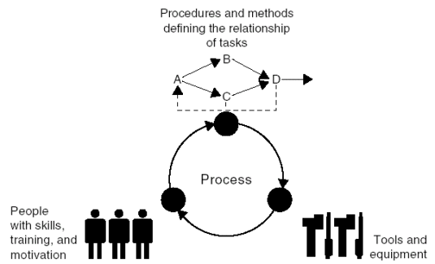
Three Critical Dimensions

Slide 15
Software Engineering is a Layered Technology
Tools
Methods
Processes
Quality Focus

Slide 16
Process, Methods, and Tools
Process
  Provides the glue that holds the layers together; enables rational and timely development; provides a framework for effective delivery of technology; forms the basis for management; provides the context for technical methods, work products, milestones, quality measures, and change management.
Methods
  Provide the technical aspects ("how to“) for building software; rely on a set of basic principles; encompass a broad array of tasks; include modeling activities.
Tools
  Provide automated or semi-automated support for the process and methods (i.e., CASE tools).

Slide 17
Generic Process Framework
Communication
  Involves communication among the customer and other stake holders; encompasses good requirements gathering.
Planning
  Establishes a plan for software engineering work; addresses technical tasks, resources, work products, and work schedule.
Modeling (Analyze, Design)
  Encompasses the creation of models to understand the requirements and the design better.
Construction (Code, Test)
  Combines code generation and testing to uncover errors.
Deployment
  Involves delivery of software to the customer for evaluation and feedback.

Slide 18
Umbrella Activities
Software requirements management
Software project planning
Software project tracking and oversight
Software quality assurance
Software configuration management
Software subcontract management
Formal technical reviews
Risk management
Measurement – process, project, product
Reusability management (component reuse)
Work product preparation and production

Slide 19
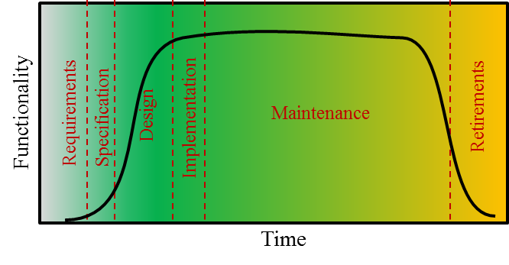
“Classical” Software Life Cycle
Series of Development Steps, from Concept Exploration through Final Retirement, Broken into 6 Phases:
Requirements phase (includes rapid prototyping)
    Concept is explored
    Client’s requirements are elicited
Specification/Analysis phase (contract)
    Client’s requirements are analyzed and presented in the form of a specification document (what the product is supposed to do)
    Software project management plan (SPMP) is generated at the conclusion of this phase, which describes the proposed software development process in detail (might include the specification document).
Design phase
    Architectural design - high-level (project broken into modules)
    Detailed design - low level (each module is designed)
Implementation phase (coding/testing)
  Developer
    Each component is coded and tested separately (Unit testing)
    Then components are integrated and tested as a whole.
  Customer
    Acceptance Testing
    Phase ends when the product is accepted by the client and installed.
Post-delivery Maintenance phase (any changes after acceptance)
Retirement

Slide 20
Why there is No Planning Phase?
In the classical software life-cycle, there is no planning phase
3 types of planning activities take place in the classical paradigm:
  Preliminary planning
    For managing the requirements and analysis/specification phases
  Software Project Management Plan (SPMP)
    Can be created once you know what should be developed (after customer approves specification document)
    Includes: budget, staffing and a detailed schedule
  Monitor SPMP through remainder of project
    Be on the lookout for any deviations
    May be necessary to reassess the feasibility of the project if significant deviations are observed, which might result in:
      Reduction in project scope
      Scrapping the project
Planning activities take place throughout each phase

Slide 21
Why there is no Testing Phase?
Cannot treat testing as a separate phase
  Danger is that testing will not be carried out constantly throughout every phase of the product development and maintenance.
Testing only the day before the project is submitted
  Too late
Software Quality Assurance (SQA) group
  Primary responsibility is to test and verify that the product being delivered adheres to the client’s specifications and performs as expected.

Slide 22
Why there is No Documentation Phase?
Same reason why there is no planning or testing phase
At all times, the documentation of the product must be:
  Complete
  Correct
  Up-to-date
Why it is important?
  Helps prevent human errors
    Think of how a written recipe helps you turn out a quality meal, despite its complexity and length
  Large turnover of personnel within the industry
  Sets standard for success in product testing
  Makes maintenance possible
    must know what the current version does before you attempt to change it.

Slide 23
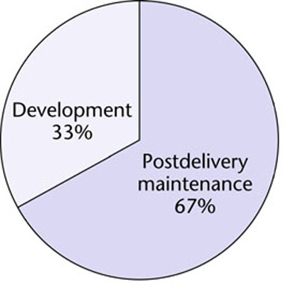
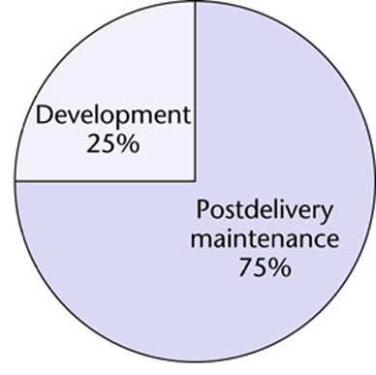
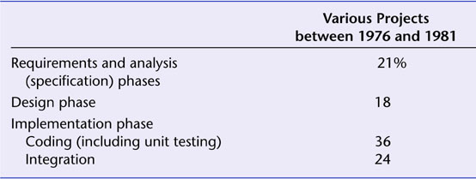
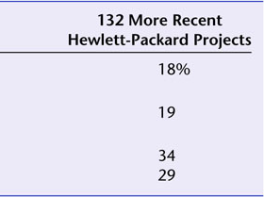
Where is software development $$$ being spent?
1976-1981
1992-2010

Slide 24
Activity: Card and Tape game
Take a deck of playing cards split the students into 6 to 8 teams, give the students cello tape and card, give them 8 minutes and ask them to built towers of at least two layers and ask them the tower must with hold minimum of 1 kilo grams. Say them the cards must not lie one above the other. Give them the sheet of paper too.
After 8 minutes…..

Slide 25
Answer
Ask them the question are you software engineers or programmers?
Check the sheet of paper and see whether the student has drawn any plan.
Most of the students would have not drawn any plan they would have directly executed.
Most of the students would have not argued for the feasibility of the project and the specification incompleteness.
Time management will again be missed.
Say them they are only programmers if they didn’t follow anything.

